Slide 1
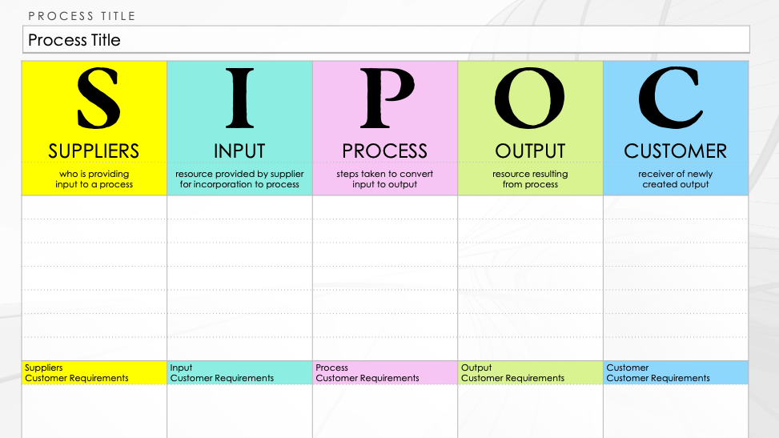
SIPOC Diagram Template
SIPOC stands for suppliers, inputs, process, outputs, and customers. A SIPOC diagram provides a high-level, visual overview of a business process, which is helpful for identifying and summarizing all of the elements in a process improvement project from start to finish.

Slide 2
PROCESS TITLE
Process Title
SUPPLIERS | INPUT | PROCESS | OUTPUT | CUSTOMER
who is providing input to a process | resource provided by supplier for incorporation to process | steps taken to convert input to output | resource resulting from process | receiver of newly created output
Suppliers Customer Requirements | Input Customer Requirements | Process Customer Requirements | Output Customer Requirements | Customer Customer Requirements

Slide 3
DISCLAIMER Any articles, templates, or information provided by Smartsheet on the website are for reference only. While we strive to keep the information up to date and correct, we make no representations or warranties of any kind, express or implied, about the completeness, accuracy, reliability, suitability, or availability with respect to the website or the information, articles, templates, or related graphics contained on the website. Any reliance you place on such information is therefore strictly at your own risk.

